Slide 1
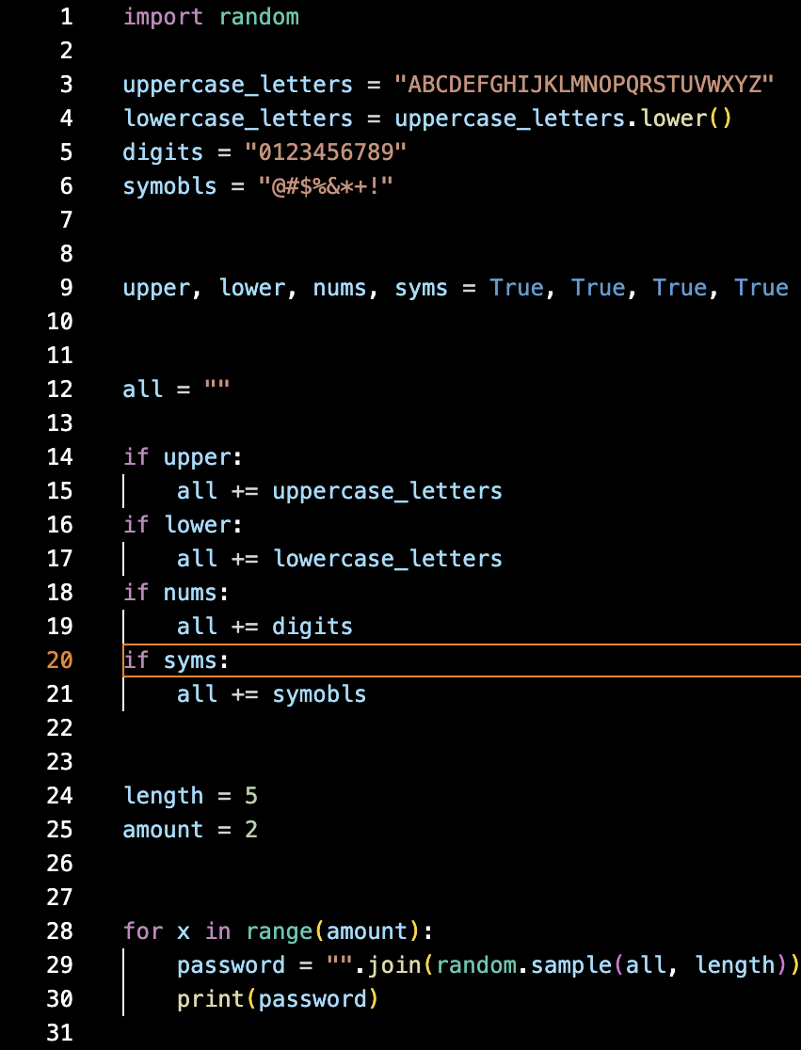
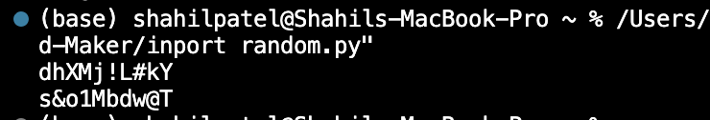
Password Generator
Shahil Patel
This will create a password to your liking, will allow symbols, letters, number, and the amount of characters you want

